Slide 1




Chester Upland
School District
FEBRUARY 2024
FEBRUARY 2024
STATUS HEARING
chesteruplandsd.org

Slide 2


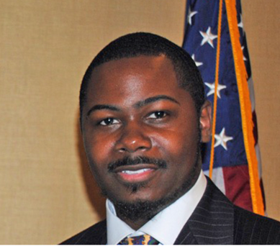

Nafis Nichols
Receiver
Latrice N. Mumin, Ed. D., MBA
Interim Superintendent of Schools

Slide 3

District-Wide Updates
1
AUDITS
4
OPERATIONS
2
FINANCIAL
5
ACADEMIC
3
RECOVERY PLAN
6
MCIU/PDE

Slide 4

BBD, LLP AUDIT PROGRESS
On-site daily since December and have provided assistance for 2020-2021, 2021-2022, 2022-2023 audits, preparation of 2022-2023 PDE Annual Financial Report and response to IRS payroll notices
Hold monthly meetings with District management regarding progress and outstanding items
Established lines of communication with the District's audit firm providing weekly information uploads for requested audit documentation
Preparing reconciliations for asset, liability, revenue and expenditure accounts
Working with District's third-party contractors to provide needed information (i.e. Chartwells, PFM and Conrad Siegel)
District's audit firm has provided a tentative start date for the 2002-2021 audit of April 1st.

Slide 5
BBD, LLP AUDIT CHALLENGES
Existing District personnel were not in place during 2020-2021. As a result, certain information is not readily available or needs to be reproduced. District has provided us access to network in order search for documents. Current District personnel is providing the necessary assistance and support to accumulate the required documentation.
Errors, incorrect and missing financial information recorded in 2020-2021 requiring analysis and correction.
District migrated to a new accounting software for 2021-2022. Prior financial software utilized was disabled and is read only. As a result, any entries that need to be made to record and/or correct have to be performed and tracked outside the financial software, creating the need to prepare additional reconciliations.

Slide 6
FINANCIAL UPDATE
AUDIT STATUS
· For fiscal year 2020-2021, BBD LLP CPA firm is currently working on completing the preliminary work and uploading requested documents into the auditor’s database.
· For fiscal year 2021-2022, BBD LLP is requesting and storing documents in anticipation for this year’s audit
· To obtain progress updates and provide any additional support to the CPA firm, the Business Office, Receiver, and Interim Superintendent meets with BBD LLP CPA firm weekly.
· Contingent upon the percentage completion of the auditor’s database, the auditors (Maillie LLP) have committed to beginning preparing the fiscal year 20/21 audit on April 1, 2024. Maillie LLP projects the audit would take 8 to 10 weeks to complete.

Slide 7
FINANCIAL UPDATE
BUDGET STATUS
· The personnel budget is being developed simultaneously with ongoing labor contract negotiations. The Human Resource department is collaborating with other departments to assess personnel needs and to identify existing vacancies.
· Preliminary budget meetings have been held to recognize areas that have been historically underbudgeted such as transportation, security, past due payables, facility maintenance, support staff, mental health and personnel.
· In order to determine budgetary needs, review facility usage efficiency models and to address expiring contracted services agreements, the district continues to conduct ongoing meetings with other budget component departments.

Slide 8
RECOVERY PLAN
Facilities Walkthroughs Conducted
Stakeholder Interviews Conducted
Documents Review In Progress
Expected Amended Recovery Plan Draft – Spring 2024
Receiver Collaboration with City of Chester

Slide 9

LEGAL UPDATE
1. Consolidation of the legal department. Including a reduction in legal costs of $750,000 per year.
2. And improvement in legal advice and representation to the school district and receiver with:
a. Review and interpretation of board policies.
b training an open meeting law and procedures.
c. Public relations and media relations.

Slide 10
LEGAL UPDATE
d. Data practices law.
e. Competitive bidding and Contracting.
f. Employee issues.
g. Review of all contracts and business transactions.
h. Insurance and Risk Management.
i. Review and management of all litigation significant reduction in lawsuits.

Slide 11
HR UPDATE
Staffing at a Glance
The district is currently preparing for the 2024-2025 school year and potential vacancies across the district. It is the district's intentions to fill positions within a timely manner so that our schools are adequately staffed to start the school year. The Department of Human Resources is working closely with the various administration departments to compile of list of positions needed based on the projected needs of the students and our schools.
Contract Negotiations
The district has begun contract negotiations with the Professional and Support staff. It is the district's intentions to reach an agreement with all bargaining entities prior to the deadlines for submitting the 2024-2025 budget to the Department of Education.

Slide 12

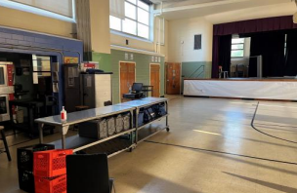
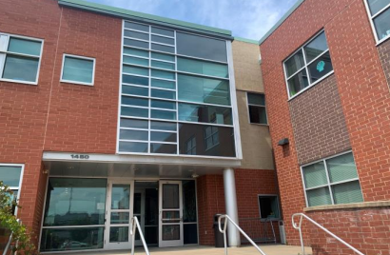
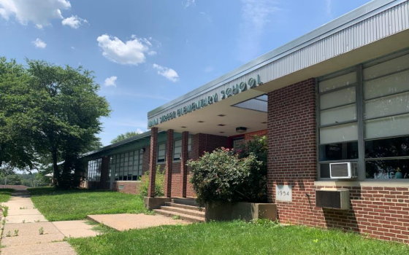
FACILITIES
  Individual building assessments completed (Summer 2023)
  District-wide facilities study completed (September 2023)

Slide 13
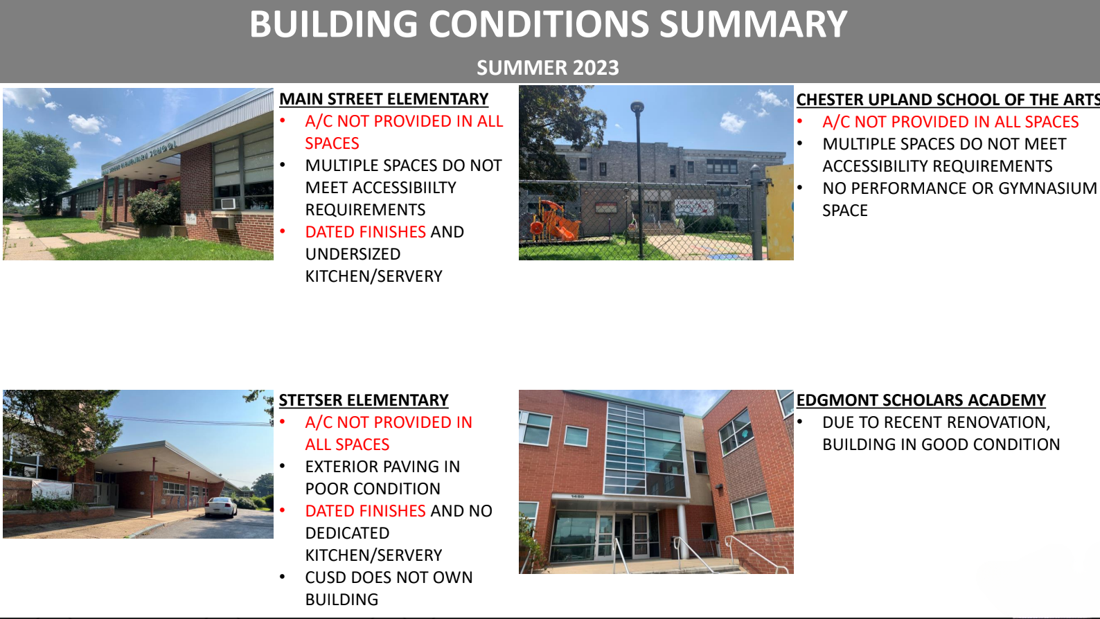

Slide 14
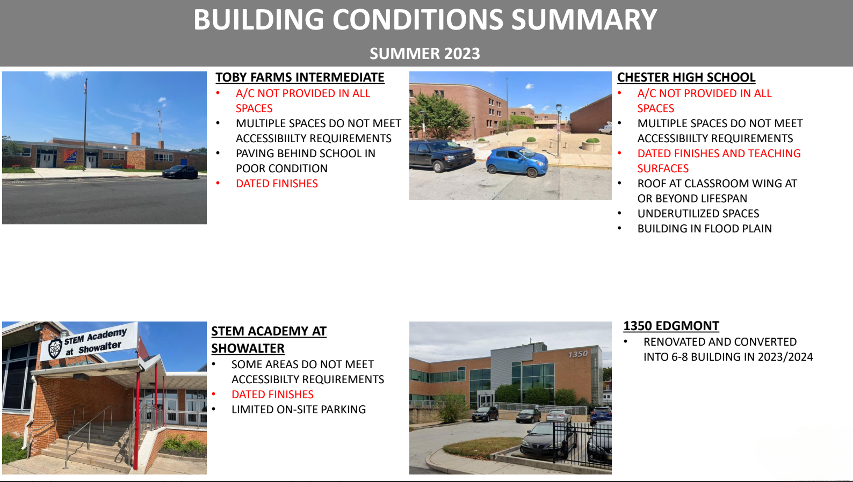

Slide 15
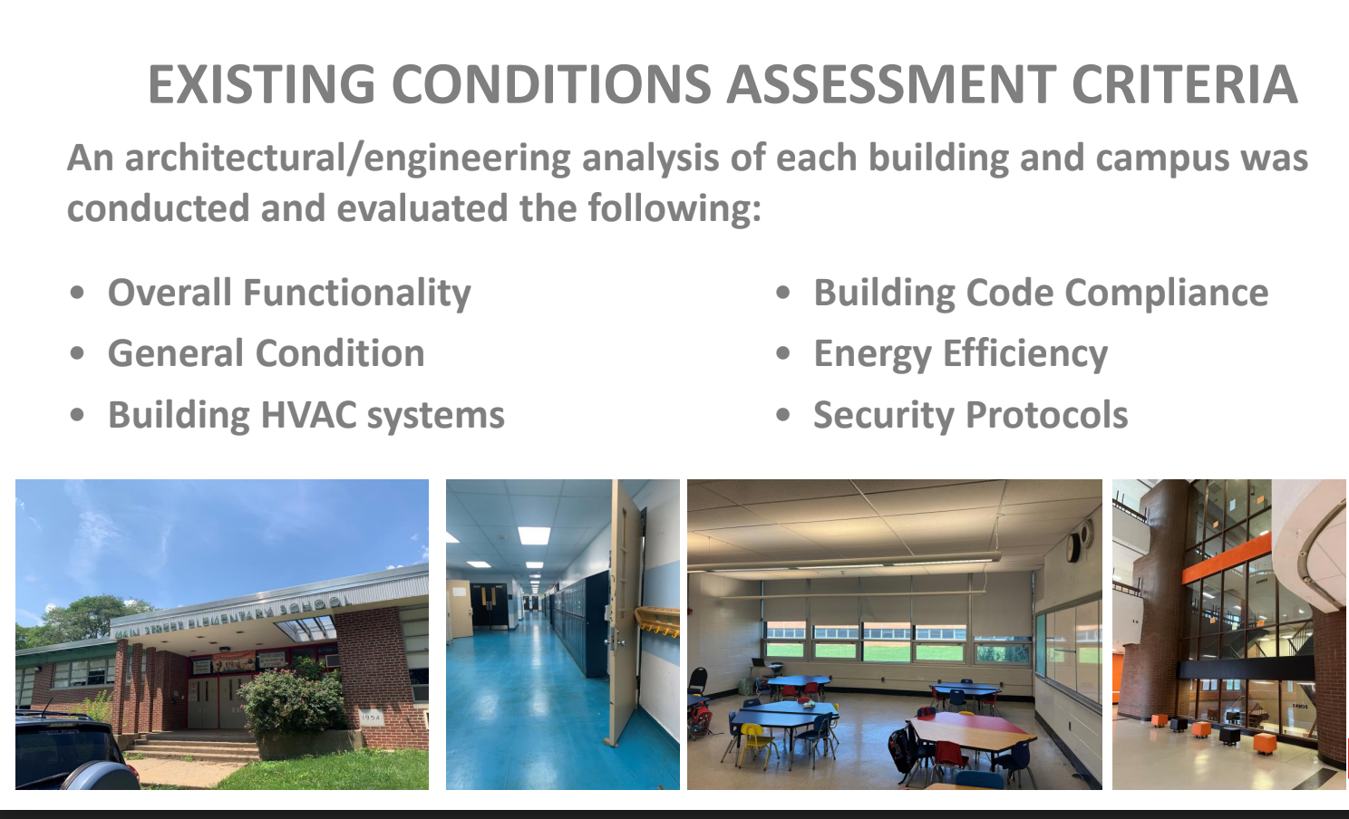

Slide 16
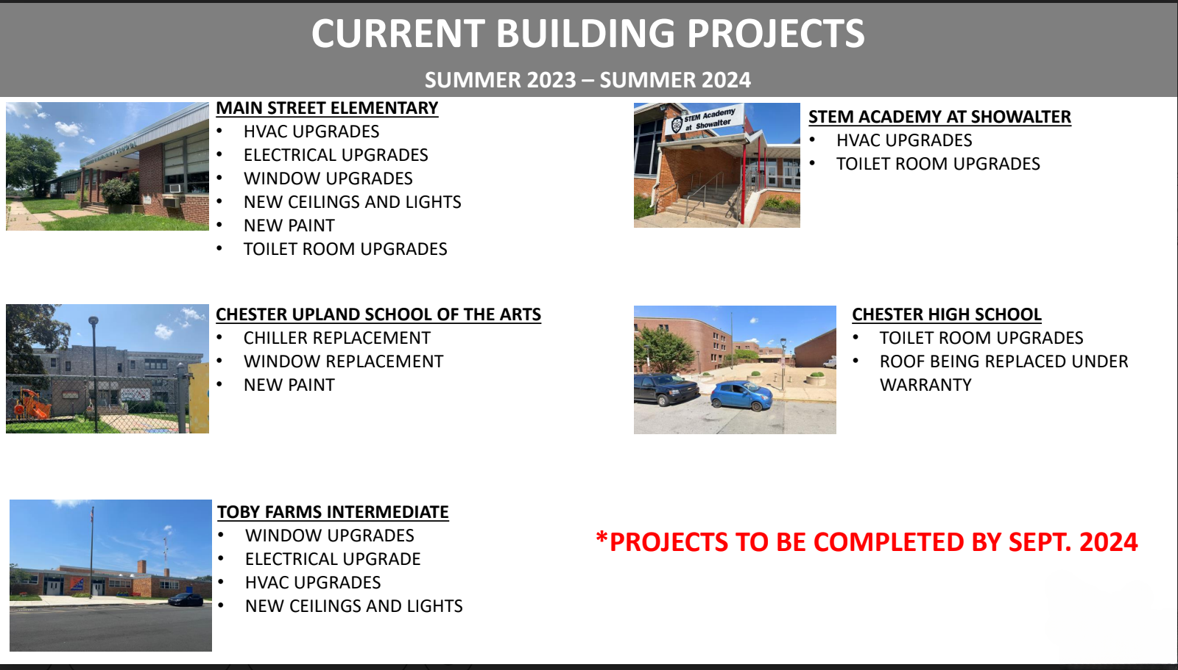

Slide 17
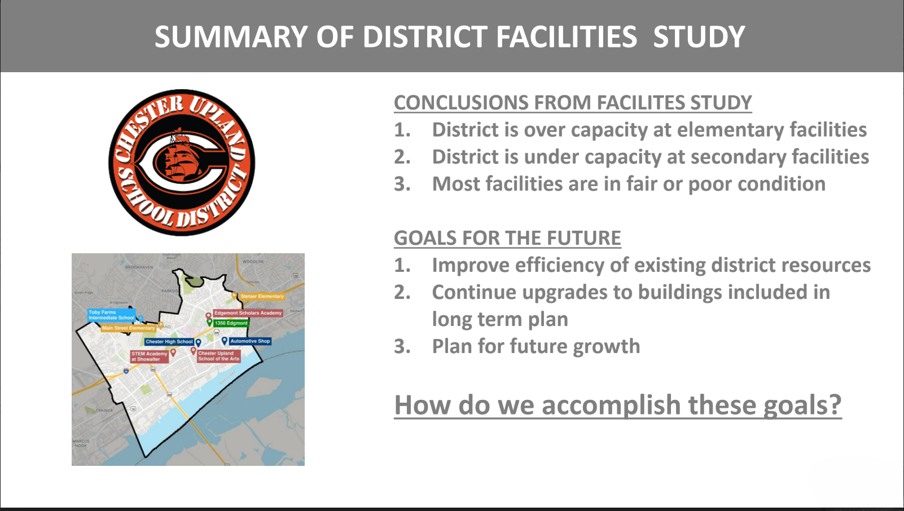

Slide 18
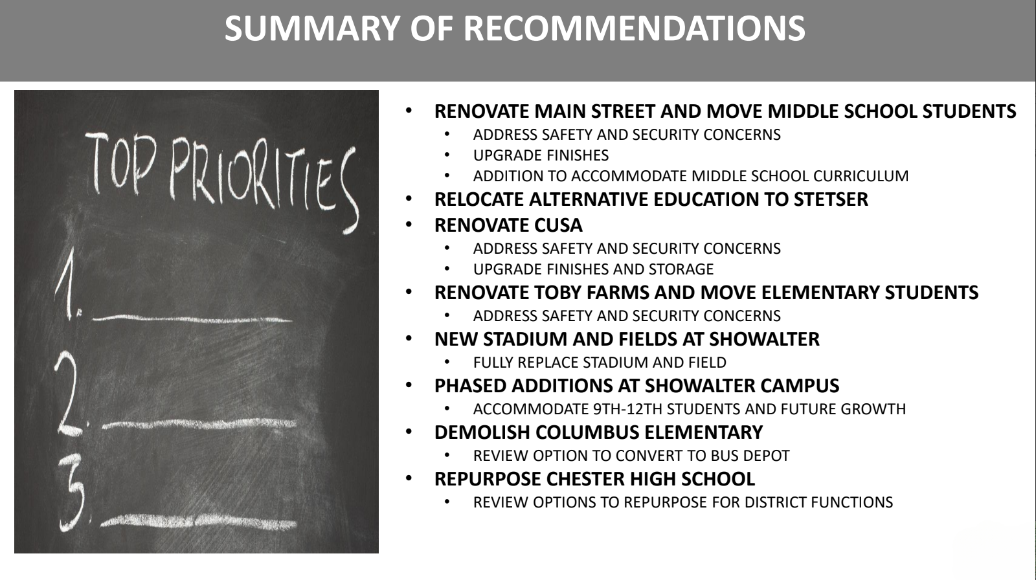

Slide 19
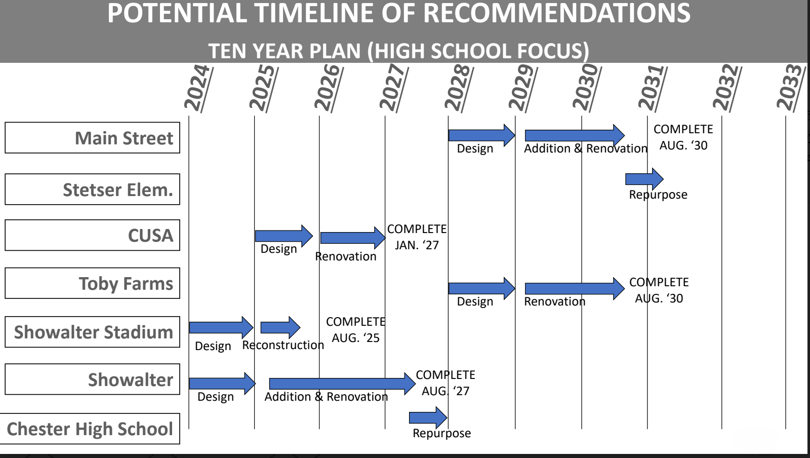

Slide 20
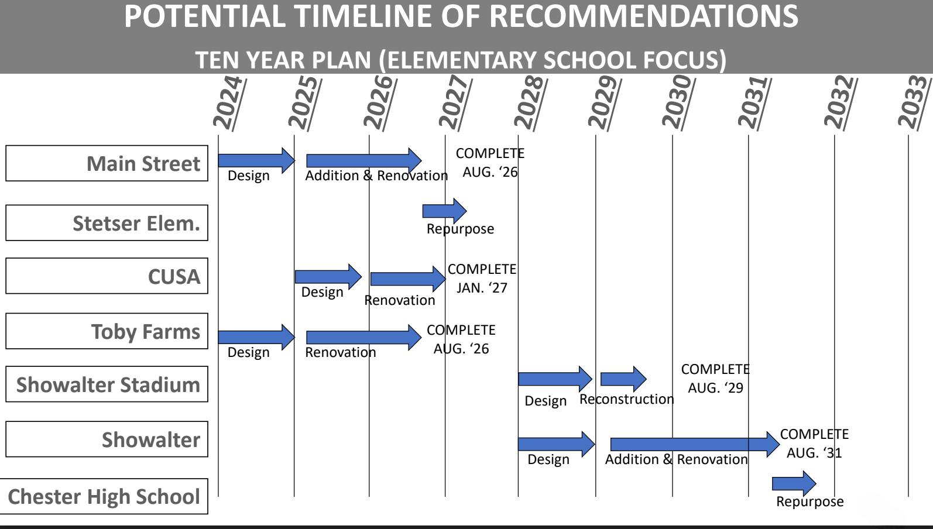

Slide 21

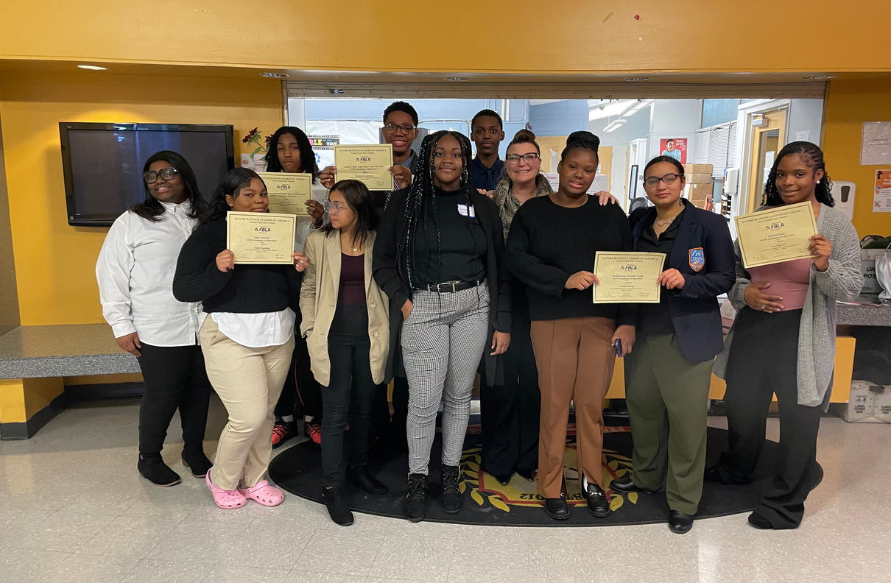
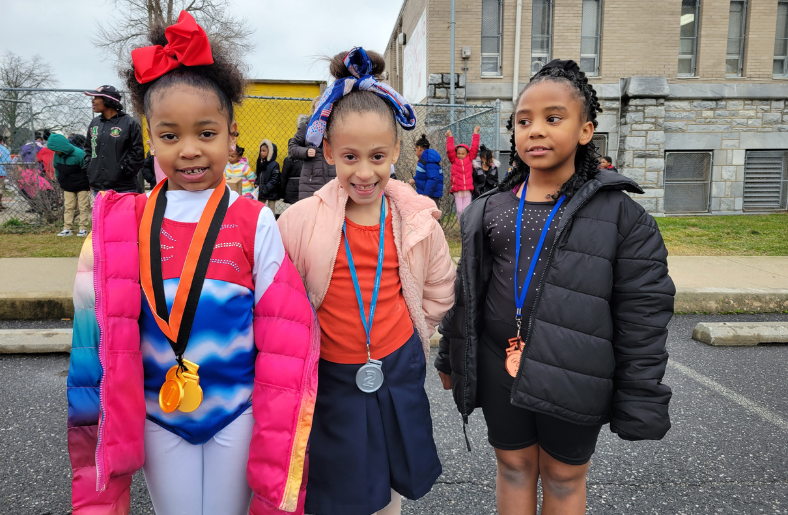
ENROLLMENT
APPROXIMATELY 3,076

Slide 22
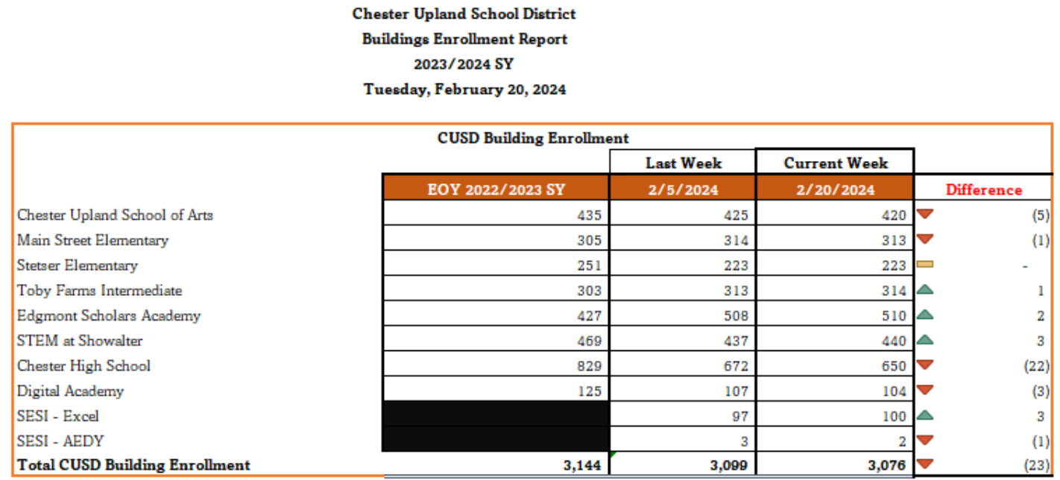

Slide 23
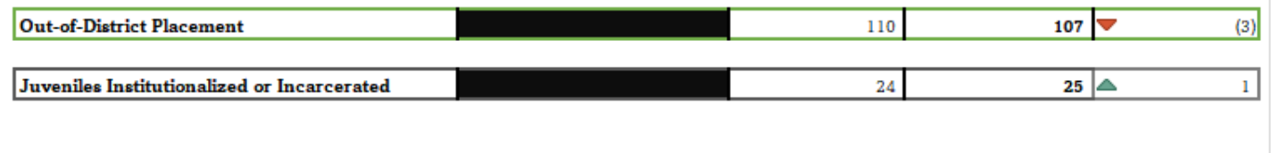

Slide 24
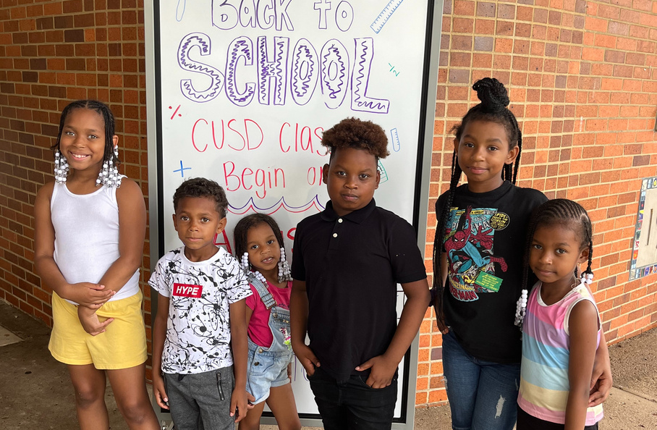
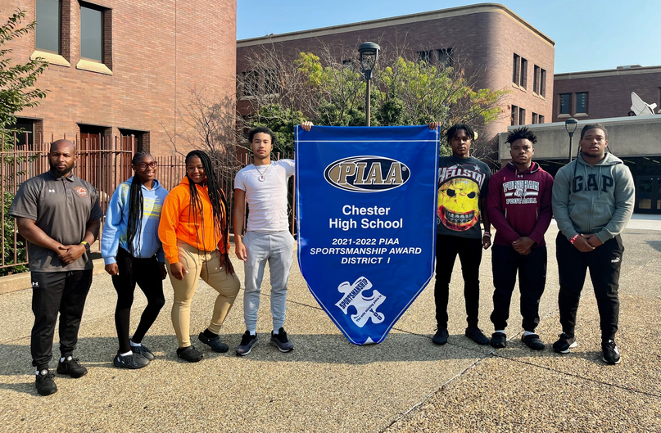
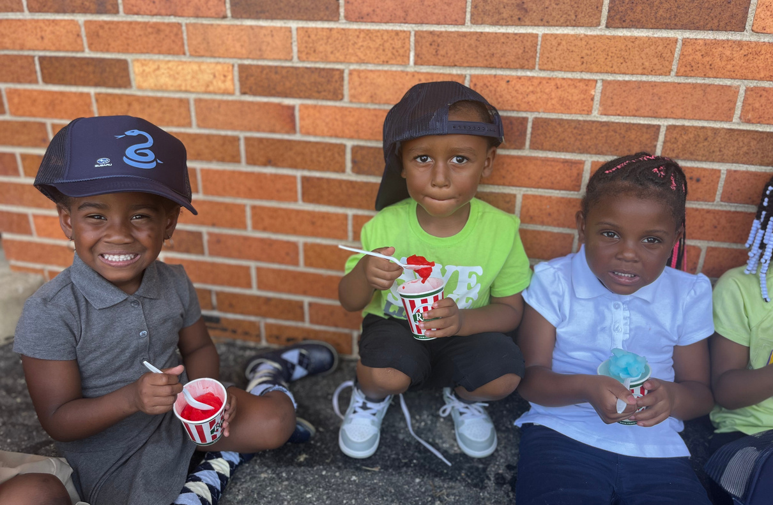
ATTENDANCE
District Attendance Average 80%

Slide 25
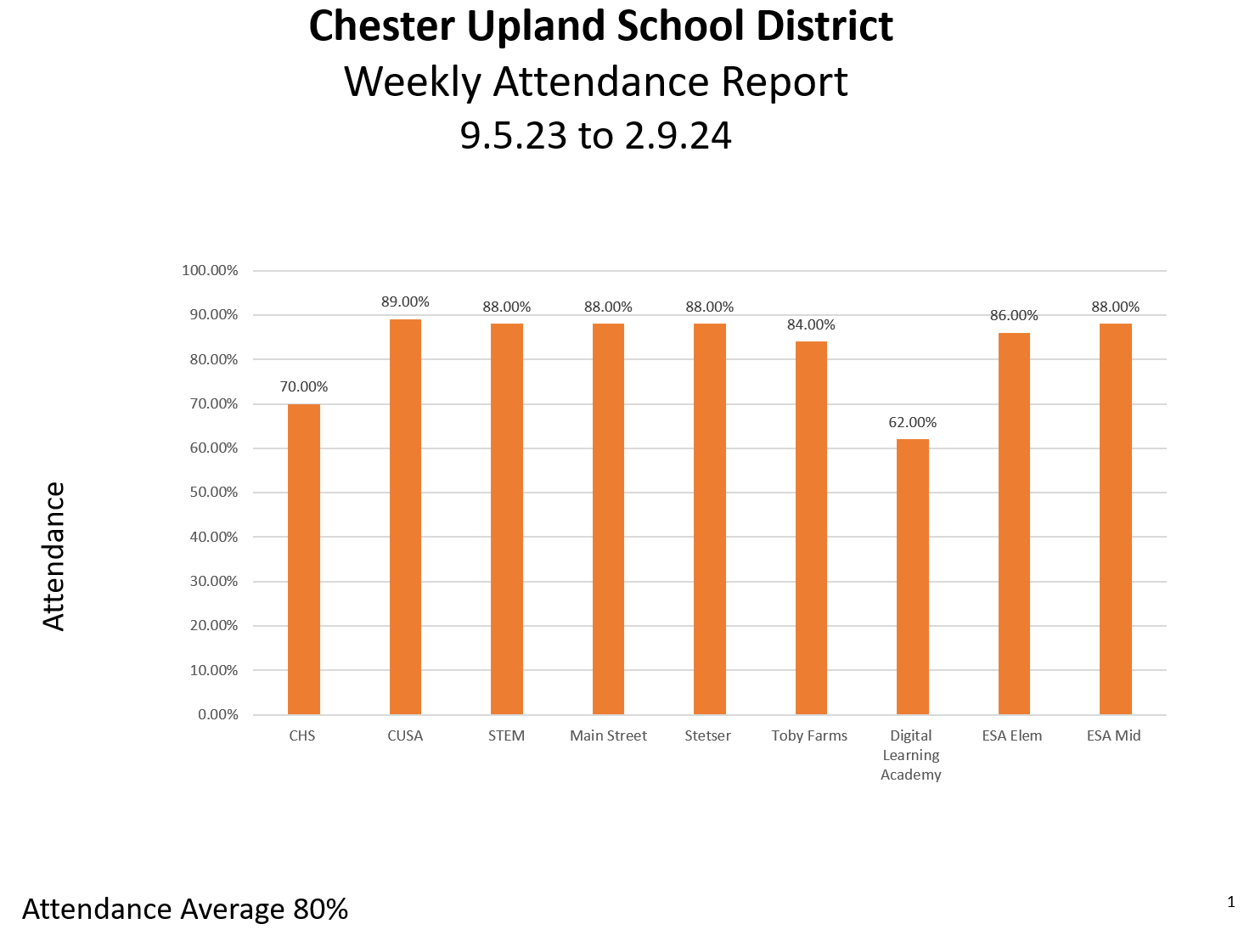

ATTENDANCE

Slide 26
CUSD Attendance Improvement Center Update
​Monitor Student Attendance District-Wide
Support School-Based Teams​
Monthly Meeting with building principals and community-based program providers Daily Operation
Monthly Meetings with individual school-based teams
Daily Operations
Schedule Student Attendance Improvement Conferences (SAIC’s)​
Create Student Attendance Improvement Plan (SAIP’s)​
Provide Daily Monitor Checks and Weekly Follow-up​
Provide supports to parents to address attendance concerns​
Provide supports to schools to address attendance concerns​
Complete phone calls, send letters and complete home visits

Slide 27
Technical Supports
  Auto-Generated calls, emails and texts to alert parents
  3/6/10 day letters and additional letters as specified
Community Based programs to promote attendance improvement​
  Justice Works - Why Try Programs (Middle & High School Programs)​
  Child Guidance Resources Truancy Prevention Partnership
  MST (Multi Systemic Therapeutic) Program
  Juvenile Probation​
Legal Courses of Action​
  District Court
  Delaware County Children and Youth Services​
Provide Residency Verification

Slide 28
ACADEMIC UPDATE
Chester Upland School of the Arts is participating in the Success for PA Early Learners grant, with a 4-year commitment. The grant is designed to improve school and family engagement, literacy skills, and continuity of transitions among educational systems for economically disadvantaged early learners at risk for, or identified with, a delay or disability. Partnering with the Delaware County Intermediate Unit and PaTTAN, teachers of Kindergarten are receiving professional learning and coaching around reading instruction. The grant will expand a grade each year through grade 3.
The district partnered with Reading Assist to provide high-dosage reading tutoring to students at each of our elementary buildings. Just recently, Reading Assist was recognized for their work with our students in Chester. You may read more about the recognition here https://www.audacy.com/kywnewsradio/news/local/gamechangers-2024-reading-assist-chester.
Chester High School hosted the district-wide Spelling Bee on February 8, 2024. 60 students in grades 1-8 participated in the Bee after successfully competing at their respective schools.
Currently, we are in the 2nd administration of our diagnostic testing. The testing window will close on February 17 with results available shortly thereafter. After testing, teachers complete data protocols to identify student gains and to design instruction moving forward.

Slide 29
SPECIAL EDUCATION SERVICES
Special Education
The reauthorized Individuals with Disabilities Education Act (IDEA 2004) in conjunction with various other federal and state laws provides guidance to schools related to special education. High-quality instructional services depend on general educators and special educators collaborating to provide access to the general education curriculum for all students. Hopefully, this clarification of the opportunities available for special education staff and regular education staff to collaborate with each other in the implementation of our instructional programs will support flexible approaches to instructional delivery. Ultimately, we hope that this will improve student reading performance and close achievement gaps within our school district.
Students at Chester Upland School District may receive academic remediation, gifted support, hearing/speech, physical-occupational therapy, and other related services. The needs of each student are assessed by the IEP team in cooperation with the parent or guardian. Chester Upland School District is and has been moving in the direction of inclusive classrooms. An inclusive classroom is a classroom in which a general education teacher and a special education teacher work collaboratively to educate students in the regular education setting. This means that children have the expertise of both the regular education teacher and special education teacher.

Slide 30
PUPIL SERVICES
Counseling Department
School counselors and social workers are continuing to implement Tier 1 Guidance lessons in classrooms. Additionally, high school counselors have been engaged in 1:1 and small group sessions with students related to credit audits, post secondary options, and Act 158 Pathways to Graduation. Counselors and social workers are currently planning Spring Career related activities tentatively to take place in April/May which will be a district-wide initiative and details to follow.
In the Fall, The Counseling Department at STEM and Chester High School was pleased to host its Fall Career Fair in the Chester High School gymnasium. Students had a chance to engage with guest speakers, participate in mock interviews, and interview with some local employers. There were more than 20 agencies in attendance with all students from Chester High and STEM participating. Also, Edgemont Scholars Academy hosted a Career Exploration event for its middle school students in partnership with DELCORA and other community leaders.

Slide 31
PUPIL SERVICES
Multi-Tiered System of School Supports (MTSS)
Since the start of the 2023-2024 school year, CUSD has taken several important steps to strengthen its MTSS process (prereferral) at each of its buildings. This work is in conjunction with the findings of the 2021 Special Education Audit and based on the current Special Education Plan based on the district’s responsibility to demonstrate our use of the least restrictive environment both within the realm of Special Education and prior to identification for services. Specifically, the district has:
  established a district-wide MTSS Leadership Team
  established initial recommended Early Warning System Indicators for Attendance, Behavior, Academics: Reading, and Academics: Math
  conducted district-wide Early Warning System training through Pennsylvania Training and Technical Assistance Network
  identified MTSS Champions for each building (led by the school counselor or social workers)
  established school-level MTSS Teams for each building
  purchased, held initial training, and begun district-wide use of Panorama, a data management and MTSS implementation platform
  established and communicated district-wide expectations for MTSS (please see on the next slide)

Slide 32
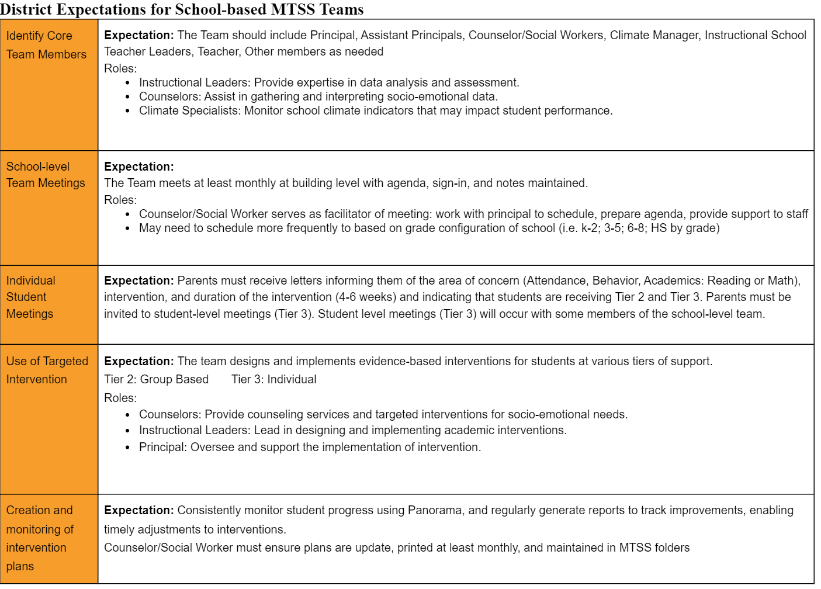
PUPIL SERVICES

Slide 33


Our Schools - Points of Pride & Opportunity

Slide 34
Chester High School
Based on our CSI Math Goal: By June 30, 2024, 65% of Algebra I students will meet or exceed their individual MAP RIT growth goal as measured by a change in their scores from the baseline assessment to the end-of-the-year assessment.
  Classroom #1: 65% met RIT growth goal
  Classroom #2: 27.59% met RIT growth goal
  Classroom #3: 78% met RIT growth goal
  Classroom #4: 20% met RIT growth goal
The 2023-24 Winter MAP assessment shows that Special Education/English Language Learners have comparable growth to General Education students.
CHS has begun the planning and implementation of educational technology to increase student engagement.
We have established partnerships with the following schools and interns:
  Social Work Intern- West Chester
    Counselor Interns- Eastern University, Widener University
Climate: Restorative Room to reset for hall walkers/class cutting

Slide 35
STEM Academy
Highlight - Academic Growth Goals: Exceed Pennsylvania Growth Standard in Algebra and Literature
According to the PA Future Ready Index, in 2022-23, STEM Academy students met the Statewide Growth Standard in Science/Biology; Exceeded the Statewide Growth Standard by 9% in Mathematics/Algebra; and Exceeded the Statewide Growth Standard by 12% in ELA/Literature
According to the nationally normed MAP Exam, 65% of Literature Students and 67% of Algebra I Students are currently exceeding expected growth during the 2023-24 School Year
STEM Academy’s Act 13 Building Level Score exceeds that of Southeastern PA high schools in comparable socio-economic districts (Chester Charter Scholars Academy, Academy Park HS, Penn Wood HS, Reading HS, William Penn (York) HS, Coatesville HS)
Areas of Opportunity
Science Teachers – currently, STEM Academy has one certified Science Teacher, one Teacher working toward certification in science, and two open Science positions. The vacant positions have been posted for over six months, without qualified applicants.
Student attendance consistently ranks as the top challenge our teachers face in the classroom. This has been exacerbated since the return from online learning, as we see reduced urgency from students and families to attend school daily.

Slide 36
Toby Farms Intermediate
137 students had 90% attendance in the 2nd Marking Period.
Building wide focus on Close Reading with support from the DCIU
Math classes focused on developing and using Universal Problem-Solving Strategy
Focus on attendance.
49% of students met 90% attendance in the 2nd marking period
Partnership with People’s Light Theater in 7th grade.
All students have 1 marking period of class and 2 field trips a year, all at no cost to CUSD
Implementing House System
Builds leadership among students
Points earned through grades, attendance, behavior referrals, and House Wars
iReady data shows growth in most areas

Slide 37
Edgmont Scholars Academy
Data informed Instruction
  Teacher data protocols to address students’ needs
  Student data chats to create student ownership of learning
  Frequent informal observations to identify trends-Strengths and Opportunities for Growth
Writing in all content areas
Questioning Strategies
  Higher Order Thinking Questions (HOT)
Academic Vocabulary/Discourse
Total Participation Techniques (TPT)
  Think Pair Share
  Cooperative Learning
Implementation of CUSD core resources with fidelity
  Houghton Mifflin Harcourt Into Reading (K-6)
  Houghton Mifflin Harcourt Into Literature (7-8)
  Savvas Learning Company enVision Math (K-8)
  Savvas Learning Company Elevate Science (K-8)
Weekly Constructed Response Practice
  Grades 3-8 (Teachers are provided with prompts)
Monthly Schoolwide Writing Prompts
  First Prompt-If I had three wishes…

Slide 38
Main Street Elementary
We celebrate our students monthly for Tiger of the Month. Quarterly for Honor roll and "Pawfect" Attendance.
Our students always place in district wide competitions.
We fully immerge all students in all programming.
We have an annual Walk for the Cure for Breast Cancer Awareness Month. We also fundraise to collect money to donate to a breast cancer survivor.
We have partnered with the Upland Police department. Officers come in and read to our students; they also visit classrooms to establish a positive relationship with the students.

Slide 39
Stetser Elementary
We are slightly below 90% average daily student attendance
3rd Grade PSSA assessment data for ELA reflects an increase in students scoring proficient and advance from the prior year's score
62% of 4th grade students scored proficient and advance in science on their PSSA assessment
24% of student score proficient and advance in math on their PSSA assessment
Overall, we've made gains in our PSSA scores, however, there's opportunity for us to make gains in all testing grades
We've had the support of two Reading Assist tutors this school year; they've made a difference with our students that struggle to read. Increasing this level of support is an area of opportunity.

Slide 40
Chester Upland School of the Arts
Heritage Bowl – winning grade team; winners for most family involvement
Multiple community partners:
Masons' 2nd District, AKA, Incorporated Tau Delta Omega Chapter, Harrah’s Heroes, Kimmel Center for Performing Arts, Walnut Street Theatre, PA Ballet, Musicopia, Amazing Family Enterprises (literacy), Scouts of America, KINF (Kids in Need Foundation), PECO, National Theatre for Children, Charity Rx
Staffing: Fully staffed classroom teachers, specialists, behavioral support staff (counselor & social Worker) with interns
Common planning time (PLCs w/ISTL) biweekly
Increased family engagement opportunities (trips, performances, visits, volunteers, etc.)
Attendance plan: daily attendance check by principal, weekly calls by behavior team, meeting with leadership, competition between classrooms (trophy for the month)
Dress code competition (Battle of the Floors) Monthly (trophy)
Flexible grouping opportunities based on student need (1st and 2nd grades)
ELA supports kindergarten (ECRI, reading specialist focus, Fundations coaching from DCIU)
ELA supports 1st – 3rd (Reading Assist, Fundations coaching from DCIU)
PBIS & Student engagement (monthly assemblies, field trips, PBIS rewards)
DCIU coaching for TDAs (Text Dependent Analysis) 3rd-5th
DCIU coaching for student engagement for mathematics (K-5)

Slide 41
Design Thinking Digital Academy
The Design Thinking Digital Academy is the Chester Upland School District virtual learning platform. Our program currently provides academic, social-emotional and developmental support to (105) students ranging from grades 5 thru grades 12. We currently have a program staff consisting of (7) staff members. Our mission is to provide our students with quality learning environment on a virtual platform.

Slide 42
Design Thinking Digital Academy
Three goals for the enhancement of our Design Thinking Digital Academy:
1. Embed a technology training workshop for all students enrolling in the Digital Academy. This will increase student enrollment as well as student attendance.
2. Expand our virtual learning platform to provide our students with additional resources such as; educational virtual tours, career and college virtual tours, and lastly, academic research tours virtually. With this concept implemented in our program, more students will be attracted to the program and remain engaged in our academics.
3. Conduct an introductory workshop with actual lessons and curriculum so that parents and guardians can review, explore, and follow their students' academic pathways.

Slide 43
Design Thinking Digital Academy
Three areas of opportunity to incorporate:
1. Conduct a more effective enrollment process for students and parents. This will allow both students and parents to preview all aspects of the Digital program with their students.
2. Increase the number of staff members for the Digital program. With additional staff members we can expand our curriculum resources and provide additional instruction across all disciplines.
3. Arrange offline and off-site learning opportunities that provide our students with exposure to programs such as internships, employment opportunities, and enhanced dual enrollment opportunities. Again, this added element to our program will be more inviting to students and create longevity for student engagement.

Slide 44
College & Career Acceptances
University of Maryland Eastern Shore
Neumann University
Clark Atlanta University
Cheyney University
Fisk University
Lasalle University
Temple University
Rutgers University
University of Michigan-Flint
Lincoln University
Bloomsburg University
Lock Haven University
Mansfield University
Daytona State University

Slide 45
College & Career Acceptances
Penn West University
Delaware County Community College
Delaware State University
Widener University
Winston Salem State University
Livingstone College
Lane College
Tougaloo College
Virginia State University
Johnson C. Smith
Elizabeth State University
Vorhees University
Benedict College
Wiley University
North Carolina Central University
Fayetteville State University

Slide 46




Social Emotional Learning
Positive Action continues to be implemented in schools across the district as Tier 1 support for SEL. To enhance SEL implementation, all schools were provided a monthly SEL calendar.
Each month focuses on a different aspect of SEL with discussion topics or short activities that can even be combined with lessons in the classroom. These activities are designed to be quick but impactful. For example, on February 1st, the calendar says to “compliment someone’s effort or hard work”. This can be written on the board, discussed, announcements, etc.

Slide 47



  All district buses will be modernized with photo enforcement technology
to tackle illegal passings
  Education campaign (started December 2023)
  Equipment Installation (February 2024)
  Go Live (March 2024)
Safety Program

Slide 48


Art Therapy Program
Thanks to grant funding CUSD was awarded through the Bureau of Justice Assistance (BJA)STOP School Violence Program, we have partnered with The Lincoln Center for Family and Youth to provide art therapy services to students to support their mental health and well-being.
Eligible students MUST BE referred to participate in the art therapy program. School faculty members and parents/guardians can refer students.

Slide 49
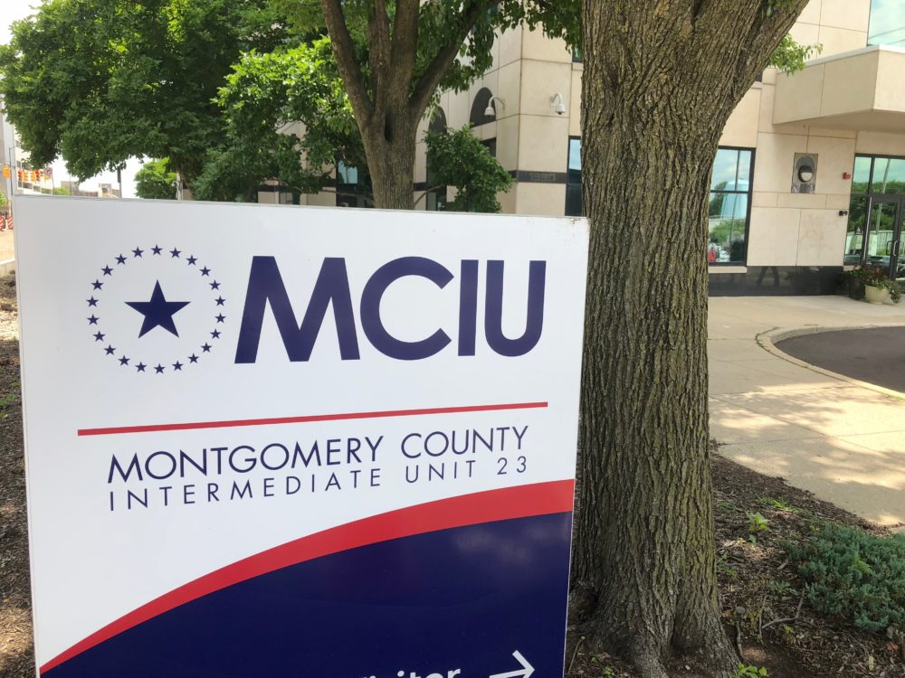
MCIU
On-going district support to Receiver, Board of Directors, Interim Superintendent, and Central Office Administration.

Slide 50

PDE Support
Monthly Receiver’s Meetings with CUSD Leadership
Special Education Support Services
Data Analysis
Leadership Development Planning
  Principal’s Academy
Recovery Plan Amendments
  Mass Insight
  PFM

Slide 51





Contact Us
484-763-2831
www.chesteruplandsd.org
1350 Edgmont Avenue, Chester, PA 19013

Slide 52
Thank You
CHESTER UPLAND SCHOOL DISTRICT
chesteruplandsd.org

